Slide 1

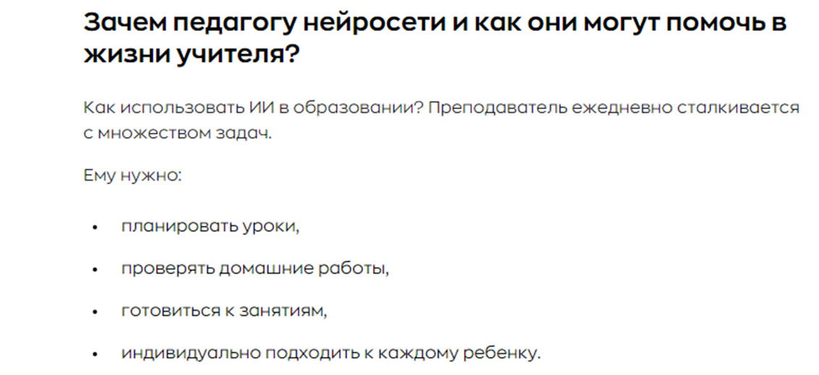
Искусственный интеллект в подготовке к ВПР. Плюсы и минусы.

Slide 2
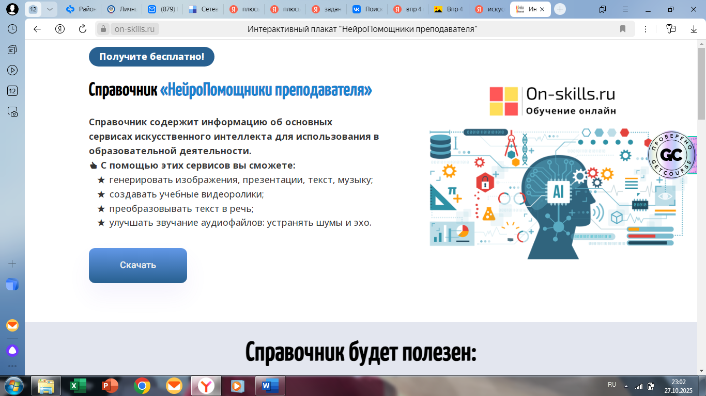

Slide 3
Помоги своему другу заполнить анкету для сайта «Друзья он-лайн». Прочитай текст и запиши информацию в таблицу. Под каждым номером запиши только одно слово (без артиклей). Числа необходимо записать словами.
Tom Ivanov
Tom is from Russia. He is 10 years old. Tom lives in Saratov. He has got a younger sister and an older brother. The children have got a cat. Tom likes playing football. He wants to be a professional football player in the future. He is a good pupil. His favourite subject is Maths. He likes juice. But he doesn’t like milk.
Name | 1.
Age | 2.
Country | 3.
Number of children in the family | 4.
Pet | 5.
Favourite subject | 6.
Favourite drink | 7.
Favourite sport | 8.

Slide 4
Lucy Adams Lucy is from Australia. She is 7 years old. Lucy lives in Sidney. She was born in April. She has got a small family, one brother and a mother. The children love to play with their dog. Lucy would like to take care of a puppy. Lucy loves everything related to computers and artificial intelligence. She wants to become a scientist. Her favourite subject is Maths. She drinks tea every morning, but she likes a refreshing fruit juice.
Name | 1.
Age | 2.
Country | 3.
Number of children in the family | 4.
Pet of his dream | 5.
Month of birth | 6.
Favourite drink | 7.
Interest | 8.

